Slide 1
Technical Support (420-1N6-AB) Hardware Introduction – Part III
Fall 2021

Slide 2
Outline
Last week we learned about how information is represented in computer systems (binary, logical circuits).
In particular, we saw how simple switches could be used to represent AND, OR, XOR, and NOT logic in electrical devices.
Combining these simple “gates” to produce more sophisticated devices allows computer engineers to created Integrated Circuits (ICs), or, as we more commonly call them, Chips.
We now know enough to learn finish learning about some of the most important ICs in a computer introduced in Week 2:
Chipsets
Central Processing Unit (CPU)
Graphical Processing Unit (GPU)
Memory and Storage Devices

Slide 3
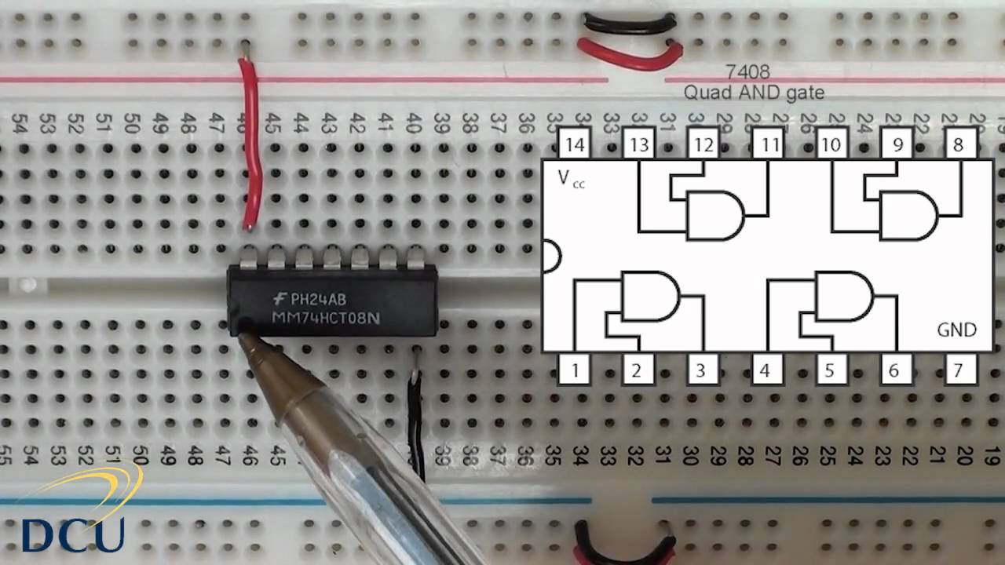
Logic Gates -> Integrated Components (Chips)

Slide 4
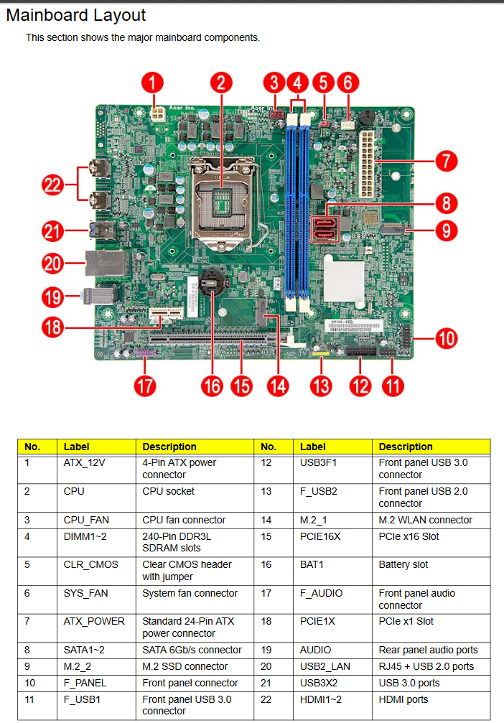
Integrated Components (Chips) -> Motherboard
Acer T3-710 Motherboard Schematic -- composed of many integrated components

Slide 5
More on Chipsets

Slide 6
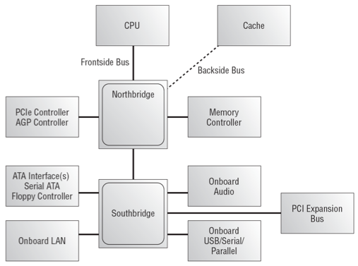
(from Lecture 2) the Chipset

Slide 7
More on Chipsets
Reminder
Chipsets are a major component of the of the motherboard.
A chipset controls the communication between the CPU, RAM, storage and other peripherals.
A chipset dictates hardware compatibility across components.

Slide 8
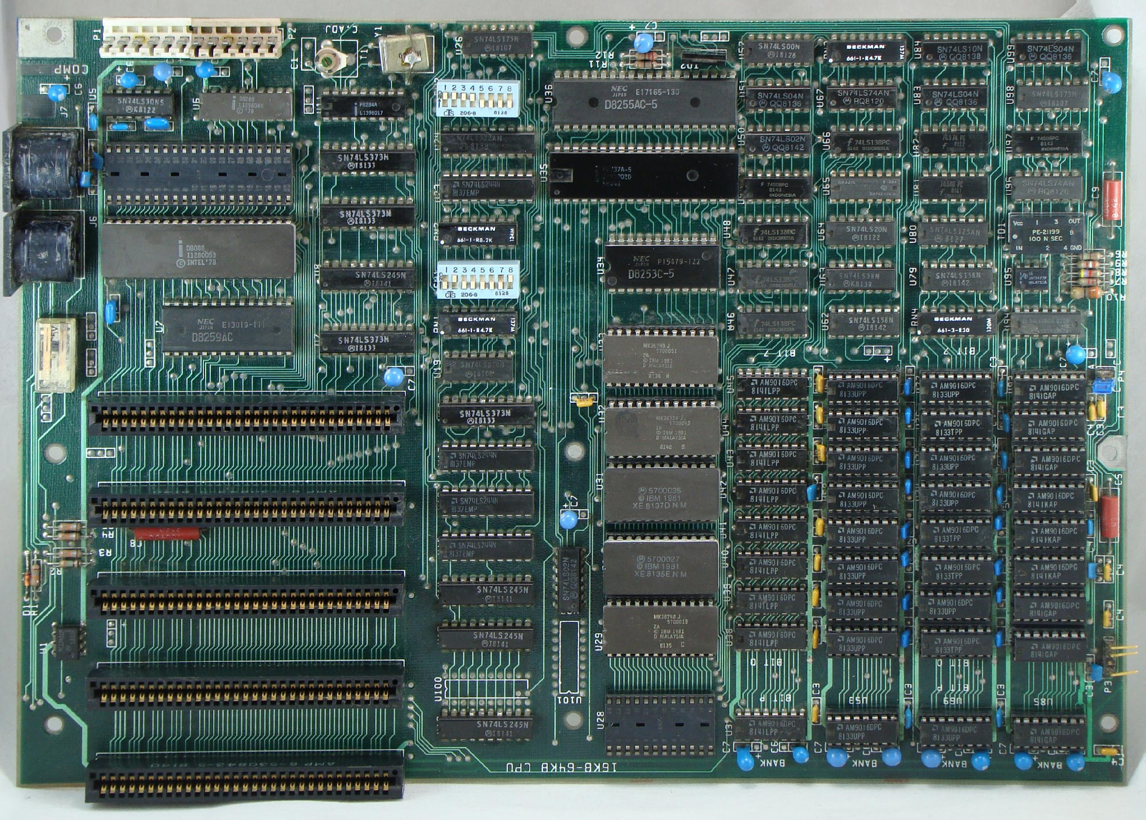
How did Chipsets Evolve?
Older motherboards were designed with a lot of different chips scattered all over the motherboard.
There were a lot of different chips controlling different functions on the motherboard:
Chips for bus controllers, memory controllers, keyboard controllers, and so on.

Slide 9
How did Chipsets Evolve? (cont.)
As technology progressed, computer engineers decided to reduce the number of chips and have them more in a centralized location so instead of having these different chips scattered all over the motherboard controlling different functions.
The number of chips was reduced to few chips that do the same job or what's now called a chipset.

Slide 10
So.. What is Chipset?
A chipset is a smaller set of chips that has replaced a larger amount of chips.
Chipsets job is to control data flow between the CPU, the peripherals, bus slots, and memory.
All the different computer hardware components communicate with the CPU through the chipset.
Most chipsets are divided into two distinct components:
Northbridge
Southbridge

Slide 11
Northbridge Chipset
Directly connected to the CPU, main memory, graphics card and PCI-Express.
Connection between the northbridge and CPU is known as the frontside bus.
Any communication between the above components must go through the northbridge first.
To communicate with any other components, the communication goes through the northbridge then the southbridge.
Northbridge is faster than the southbridge.
Why? Northbridge is optimized for speed (actions per second) since it connects the most used and most important components of the motherboard.
Faster actions per section comes at a cost! The Northbridge is a source of heat and needs to be places by heatsinks and fans.
These days the Northbridge is often directly a part of the CPU, while the Southbridge remains separate.

Slide 12
Southbridge Chipset
Connected to the northbridge.
Acts as a communication hub for less performance sensitive components.
Storage devices (SATA and IDE connectors).
PCI bus slots.
I/O Ports (USB ports, networking, sound card, etc.)
Southbridge does not require high speed communication like the northbridge.
To send data from the hard drive to the main memory:
Data goes to the southbridge.
Southbridge sends the data to the northbridge.
Northbridge will send the data to the main memory.

Slide 13
Modern Motherboards and Chipsets
Modern chipsets integrate the northbridge chips within the CPU chip.
New design advantages:
Sensitive hardware components communicate directly with the CPU.
Reduces system latency.
Increases system responsiveness.
Less sensitive hardware components will increase in performance.

Slide 14
Central Processing Unit

Slide 15
Central Processing Unit (CPU)
Most important element of the computer in terms of computing power.
Brains of the computer.
Responsible for interpreting and executing the commands from the software.
The processor executes a program (sequence of stored instructions).
While the CPU is processing one step of the program, the remaining instructions and the data are stored in a special memory called cache.
Almost all modern devices include a CPU:
Desktops, laptops, tablets, smartphones, TVs, TV boxes, Vending machines, traffic lights, Smart devices (Fridge, washer, light bulbs)

Slide 16
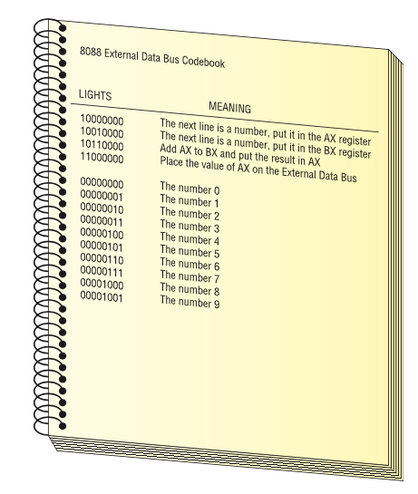
CPU Reminder (Lecture 2)
10000000 The next line is a number, put it in the AX register 00000010 The number 2 10010000 The next line is a number, put it in the BX register 00000011 The number 3 10110000 Add AX to BX and put the result in AX 11000000 Place the value of AX on the external data bus
A set of commands such as this is called a program. A program is a series of command sent to a CPU in a specific order for the CPU to perform work.

Slide 17
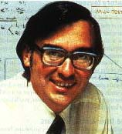
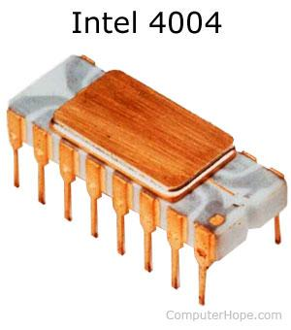
CPU History
First CPU: Intel 4004 processor:
Developed at Intel Corp by Ted Hoff.
Introduced in 1971.
Design:
108 kHz (2,300 transistors).
Performed 60,000 OPS (operations per second)
Addressed 640 bytes of memory.
Cost $200.00.

Slide 18
CPU Manufacturers
Intel and AMD are the two most popular manufacturers of CPUs for desktops, laptops, and servers.
NVIDIA, Qualcomm, Samsung and Apple are major manufacturers of mobile CPUs.
Used in smartphone, tablets, TV boxes, etc.

Slide 19
CPU Features

Slide 20
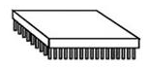
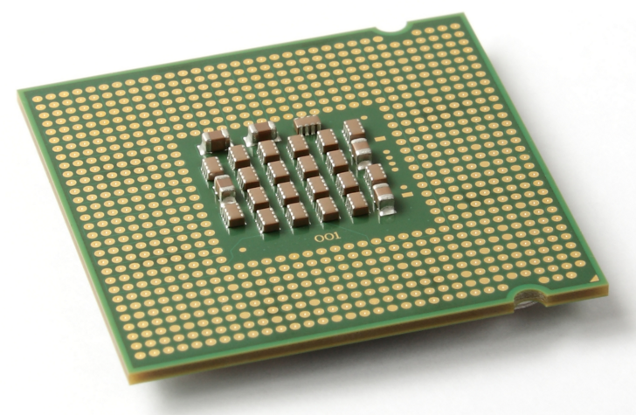
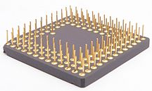
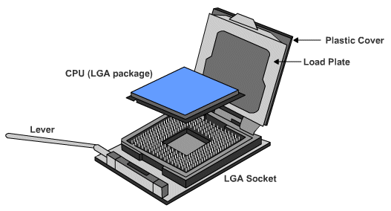
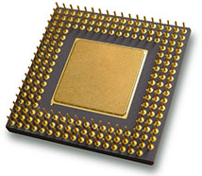
How to Connect a CPU?
CPU connection on the motherboard is known as the CPU socket.
The CPU is connected to the motherboard in one of two ways:
Pin Grid Array – PGA
Pins are on the CPU (underside of the processor).
Socket on motherboard includes holes that line up with the CPU pins.
Land Grid Array – LGA
Pins are on the motherboard (on socket) instead of on the processor.

Slide 21
CPU Components
There are two primary components for a CPU:
Arithmetic Logic Unit – ALU:
Performs basic arithmetic calculations like adding, subtracting, multiplication and division of numbers.
Performs logical operations like the comparison.
Control Unit – CU:
Controls all operations taking place within the processor.
Instructs the ALU on which arithmetic/logical operation is to be performed.
Acts under the direction of the system clock.
Sorts out all the internal data paths inside the processor to make sure that data is fetched from the right place and delivered to the right place.

Slide 22
Other CPU Components
Registers: a temporary storage used to store data:
Coming from memory heading to the processor for execution.
Coming from the processor after processing
Being worked on by the processor.
Internal Data Bus: connects the internal components of the processor to the motherboard.
External Data Path: used to fetch data from memory to the processor.
Address Lines: used to specify the exact location in memory where data can be found.

Slide 23
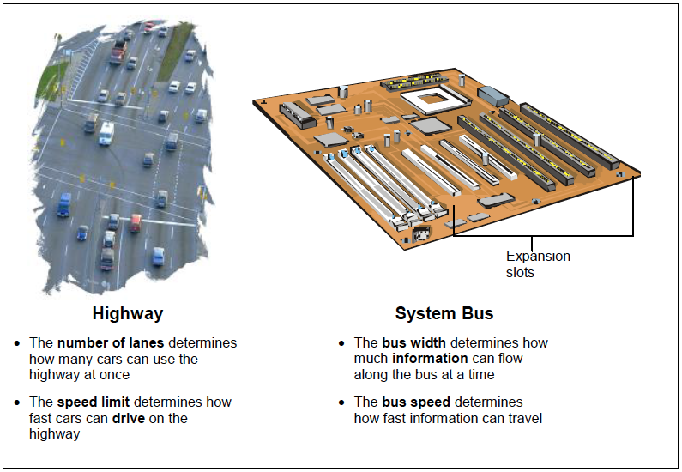
Remember: Why is the bus important?
You can double check that you understand a scientific concept by checking what units of measurement that concept is measured by:
Highway
Number of lanes: (a number)
Speed limit: (unit distance per time elapsed, e.g. km/h)
System bus
Bus width: (a number of bits, eg a 32-bit processor)
Bus speed: (unit information per time elapsed, e.g. bits/second)

Slide 24
CPU Power
CPU power is measured by both speed and the amount of data it can process.
Speed: is rated in cycles per second, e.g. megahertz (MHz) or gigahertz (GHz).
Hertz (Hz) is the unit of measurement that represents the idea “per second”. So MegaHertz (million Hertz) means “one million times per second”
The amount of data processed at a time depends on the side of the FSB (front side bus) (also called CPU or processor bus).
The width of a bus is measured in bits, e.g. 32-bit or 64-bit FSB.

Slide 25
Activity: Bus Speed and Bus Width (CPU Power)
Let’s say we have a 100-MHz, 32-bit bus CPU.
How many bytes per second can the CPU process?
Now, let’s compare the above CPU with a second 80-MHz 64-bit bus CPU.
How many bytes per second can the second CPU process? Which of the two is faster at sending information?

Slide 26
CPU Performance (cont.)
Overclocking: a technique used to make a processor work at a faster speed than its original specification (not recommended).
Throttling: when the processor runs at less than the rated speed to conserve power or produce less heat (commonly used in laptops and mobile devices).

Slide 27
CPU Performance (cont.)
Multi-Cores: More than one CPU core integrated into a single chip, each capable of running parallel processes

Slide 28

Activity: Research CPUs
Check the CPU activity posted on LEA.
With a partner or small group, carry out some research on newer processors and create your own table.
Include any information you feel would be useful to know if you wanted to purchase a CPU (processor).

Slide 29
Main Memory

Slide 30
Main Memory
Referred to as RAM (Random Access Memory)
RAM is a collection of integrated circuits (chips).
Considered the “Primary” storage for the CPU.
Temporary storage for data and programs that are being accessed by the CPU.
Volatile memory: contents are erased when the computer is switched off. (or when power is lost)

Slide 31
Main Memory (cont.)
More RAM means more capacity to hold and process large programs and files.
Maximum installed is limited by the motherboard and the operating system.

Slide 32
RAM Early and Current Design
Early computers had RAM installed on the motherboard as individual chips.
These were difficult to install and often became loose.
Designers and engineers then created memory modules.
Special circuit boards on which the memory chips are soldered on.
Memory modules are attached to a motherboard using memory slots.
New design allows to add or replace memory modules.

Slide 33
Memory Modules Design Types
SIMMs (Single In-Line Memory Modules)
Have a single line of connectors.
Now obsolete.
DIMMs (Dual In-Line Memory Modules)
Have two lines of connectors.
Have Wider bus (supports 64 bits) 🡪 How can this help?
Became dominant (no need to state that a memory module is a DIMM).

Slide 34
Memory Modules Types (oldest to newest, approximately)
Dynamic RAM (DRAM) | Memory chip used as main memory. Must be constantly refreshed with pulses of electricity to maintain the data stored.
Static RAM (SRAM) | Memory chip used as cache memory. Faster than DRAM and more expensive.
Fast Page Mode (FPM DRAM) | Memory that supports paging, enabling faster access to the data than regular DRAM.
Extended Data Out RAM (EDORAM) | Memory that overlaps consecutive data accesses, speeding up the time it takes to retrieve data.
Synchronous DRAM (SDRAM) | DRAM that operates in time with the memory bus. Tied to the system clock like the CPU and the memory controller. Results in very little wasted time.
Double Data Rate SDRAM (DDR) | DDR transfers data twice as fast as SDRAM. Larger buffer gives it a huge boost.
Double Data Rate 2 SDRAM (DDR2) | DDR2 decreases noise making it faster than DDR.
Double Data Rate 3 SDRAM (DDR3) | DDR3 doubles the clock rate of DDR2, consumes less power and generates less heat.
Double Data Rate 4 SDRAM (DDR4) | DDR4 arrived in 2014 with even faster speeds. (most common RAM type in desktops/laptops today)
Double Data Rate 5 SDRAM (DDR5) | Introduced in 2020, has not been widely adopted yet.

Slide 35
RAM Latency
Latency refers to the slight delay that occurs when the memory controller starts to grab a line of memory.
RAM with lower latency is faster than RAM with a higher latency.
NOTE: Latency is a general concept in physics and engineering. The Wikipedia article on Latency provides a good two sentence explanation:
“Latency from a general point of view is a time delay between the cause and the effect of some physical change in the system being observed… Latency is physically a consequence of the limited velocity which any physical interaction can propagate.”
Remember from lecture 2: CRT monitors have lower latency than LCD/LED monitors due to electrons travelling faster in a vacuum than through digital circuits!

Slide 36
Memory Redundancy / Error Checking
Memory errors occur when data is not stored correctly in the RAM chips.
Computers use different methods to detect and correct data errors in memory.
Non-parity memory.
Parity memory.
Error-correcting code (ECC) memory.

Slide 37
Memory Redundancy / Error Checking (cont.)
Non-parity memory | Cheapest level of redundancy, works fine for most applications. If a memory error occurs, the OS has no way of knowing. Data can be therefore be corrupted without warning.
Parity memory | Also called true parity. Parity memory contains extra chips that act as parity chips. A memory error can be detected and the OS is informed.
ECC memory | Also called error checking and correcting, most expensive. Detects multiple-bit memory errors and can correct 1-bit errors.

Slide 38
Working With RAM
The single hardware upgrade that improves system performance is adding more RAM.
Adding more RAM can improve:
Performance.
Speed.
Stability.
How do you know if you need more RAM:
General system sluggishness.
Excessive hard drive accessing.
Use the System Monitor on your operating system and see whether your memory usage is close to or at 100%.

Slide 39
Working With RAM (cont.)
Steps to follow:
Determine if insufficient RAM is the cause of your problems.
Pick the proper RAM for your system.
Use good installation practices (e.g. store in antistatic packaging until you are ready to install it, don’t touch the contacts on the RAM module).
Getting the right RAM:
Open the case to see how many sticks of RAM you have an how many free slots.
Check your motherboard manual to see what type of RAM your system can handle.
CPU-Z freeware can be used to give you information about your RAM.
Older systems display the RAM configuration during the initial boot sequence.

Slide 40
RAM Upgrade Example
If your motherboard can only handle DDR3 RAM, there is no point in installing DDR4 RAM.
If your motherboard does not allow more than 4GB of RAM, there is no point in putting in 2 x 4Gb RAM modules.
Traditionally adding RAM to a laptop was impossible, but now it is easy to do and some laptops have panels to allow easy access to the RAM modules.
Mixing RAM speeds is technically possible but will introduce synchronization bugs

Slide 41
Virtual Memory
Each computer has the capability to make a portion of your hard drive work like RAM when you run out of real RAM. This is called virtual memory.
It is also referred to as setting part of your hard drive aside as a “swap file” or “page file”.
When a computer starts running out of real RAM because you have loaded too many programs, the system swaps programs from RAM to the page file, leaving more space for the programs currently running.
Exam question: Why is virtual memory not good?

Slide 42
Virtual Memory: Example
Assume your computer has 4 Gb RAM.
And you have several programs installed on your hard drive (A, B, C, D).
As programs load they take up RAM. Let’s say you run programs A B and C.
At a certain point you won’t have enough RAM to run any more programs, but you want to run program D.
This is where virtual memory comes in.
A page file is created on your hard drive which acts as a temporary storage box.
Whichever program is least used (A, B or C) is swapped out of RAM and into the page file.
In this case let’s assume this is B, so B is removed from RAM and into the page file.
Then program D runs and takes up its space in RAM.
If you later click on B, it cannot run from the page file.
Again a less-used program in RAM needs to swap over to the page file.
Once that is done, program B can be swapped back into RAM to be used.
Note:
This swapping is invisible to the user, but takes time (and Windows will slow down).
If page file is accessed too frequently, user may notice the hard drive LED going crazy.
This is called “disk thrashing” and indicates the computer would benefit from more RAM.

Slide 43
Cache Memory
Static RAM is used as cache memory to store the most recently used data and instructions.
In this way it increases computer performance.
SRAM provides faster access than retrieving data from slower DRAM or main memory.
Three common types of cache memory:
L1 cache: internal cache, integrated into CPU
L2 cache: external cache, originally mounted on motherboard, now integrated into CPU.
L3 cache: used on some high end workstations and server CPUs.

Slide 44
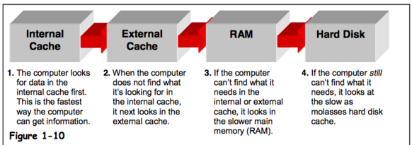
Cache Memory (cont.)

Slide 45
Read Only Memory (ROM)
ROM chips contain instructions that are directly accessed by the CPU.
e.g. booting the computer, loading the operating system.
ROM chips retain their contents even when the computer is powered down.

Slide 46
ROM Types
ROM | Read only memory. Information is written to a ROM chip when it is manufactured, it cannot be erased or rewritten, now obsolete.
PROM | Programmable read only memory Information is written to a PROM chip after it is manufactured, it cannot be erased or rewritten.
EPROM | Erasable programmable read only memory Information is written to an EPROM chip after it is manufactured, can be erased with exposure to UV light using special equipment.
EEPROM | Electronically erasable programmable read only memory Information is written to an EEPROM chip after it is manufactured. Also called flash ROM. An EEPROM chip can be erased and rewritten without having to be removed from the computer.

Slide 47
Storage Devices

Slide 48
Storage Devices
Storage devices store data permanently.
Some are installed inside the case (e.g. hard drive); Some are removable and portable (e.g. external flash drive).

Slide 49
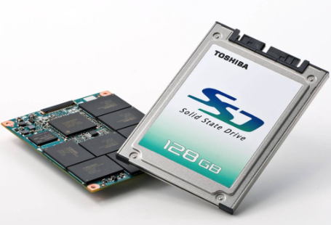
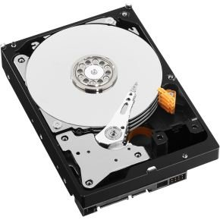
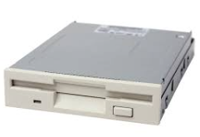
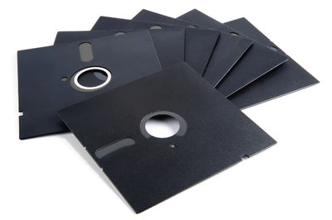
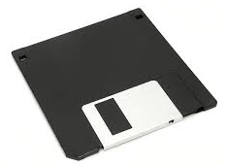
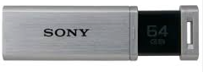
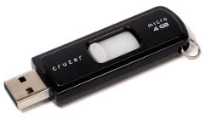
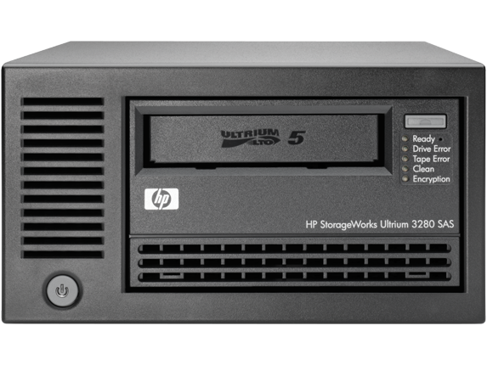
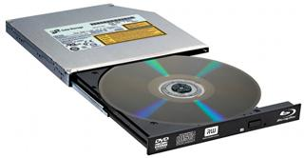
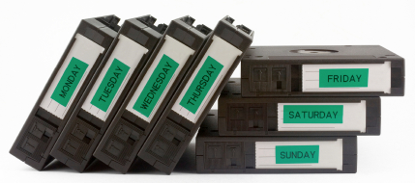
Storage Devices (cont.)

Slide 50
Storage Devices: Floppy Drive
Uses 3.5 inch floppy disks (or 5.25 inch floppy disks - older).
Largely obsolete.
Magnetic disks store up to 1.44Meg of data.

Slide 51
Storage Devices: Hard Drive
Hard Disk Drive (HDD)
Traditional hard drives.
Uses magnetic-based storage on a moving disk (somewhat like a vinyl player)
Magnetic hard drives have drive motors that spin the magnetic platters and move the drive heads.
Speed measured in revolutions per minute
Solid State Drives (SSD)
Do not have moving parts and use semi-conductors to store data.
Non-volatile flash memory chips manage the storage on an SSD, resulting in faster access to data, higher reliability and reduced power usage.
Usually configured as C: drive on a Windows machine and contains the operating system and applications. Storage capacity can range from gigabytes to terabytes.

Slide 52
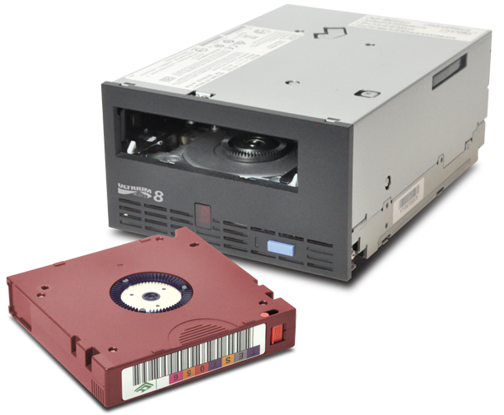
Storage Devices: Tape Drive
Magnetic tapes are often used for backups or archiving data. Still used/created to this day! Very cheap per GB costs.
Data retrieval can be fast but locating specific data is slow.
Can hold many terabytes.

Slide 53
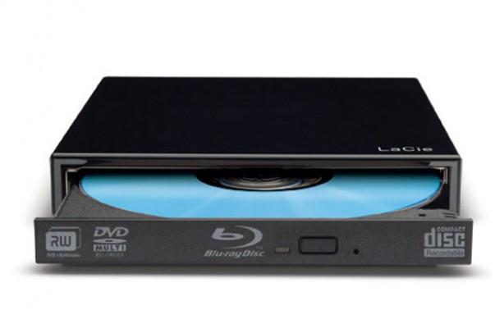
Storage Devices: Optical Drive
Uses lasers to read the data on the optical media.
CD (compact disc) 700 Mb
DVD (digital versatile disc) 4-8 Gb.
BD (Blu-ray disc) 25-50 Gb.
Optical media can be:
Pre-recorded (read only)
Recordable (write once)
Re-recordable (read and write multiple times).

Slide 54
Storage Devices: External Flash Drive
Removable storage device that connects to a USB port.
These use the same type of non-volatile memory chips as SSDs and do not require power to maintain the data.

Slide 55
Storage Devices: Interfaces
To install a drive internally in a computer, the connection interface on the drive must be the same as the controller on the motherboard.
Motherboards support different types of interfaces.

Slide 56
Storage Devices: Interfaces Types (In order of oldest to newest)
IDE | Integrated Drive Electronics / Advanced Technology Attachment. Also called ATA. Early drive controller interface, originally only supported hard drives up to 540 MB. Uses a 40 pin connector, and maximum cable length of 46cm (18in).
EIDE | Enhanced Integrated Drive Electronics (also called ATA-2). Updated version of IDE, supporting larger drives and direct memory access. Uses a 40 pin connector.
PATA | Parallel version of ATA. Used internally due to maximum cable length of 46cm (18in). Largely replaced by SATA in newer systems.
SATA (most commonly used today) | Serial version of ATA, with slimmer and longer cables providing better airflow. Uses 7-pin connector (less pins means less issues with electromagnetic interference). SATA hard drives tend to be quieter than IDE drives.

Slide 57
Storage Devices: Interfaces Types (cont.)
eSATA | External serial ATA, provides a hot-swappable external interface for SATA.
SCSI | Small Computer System Interface. Drive controller that can connect up to 15 drives. Internal and external use, uses 25, 50 or 68 pin connector.
Note: Hot-swapping is the ability to connect and disconnect a device while the computer is on.

Slide 58
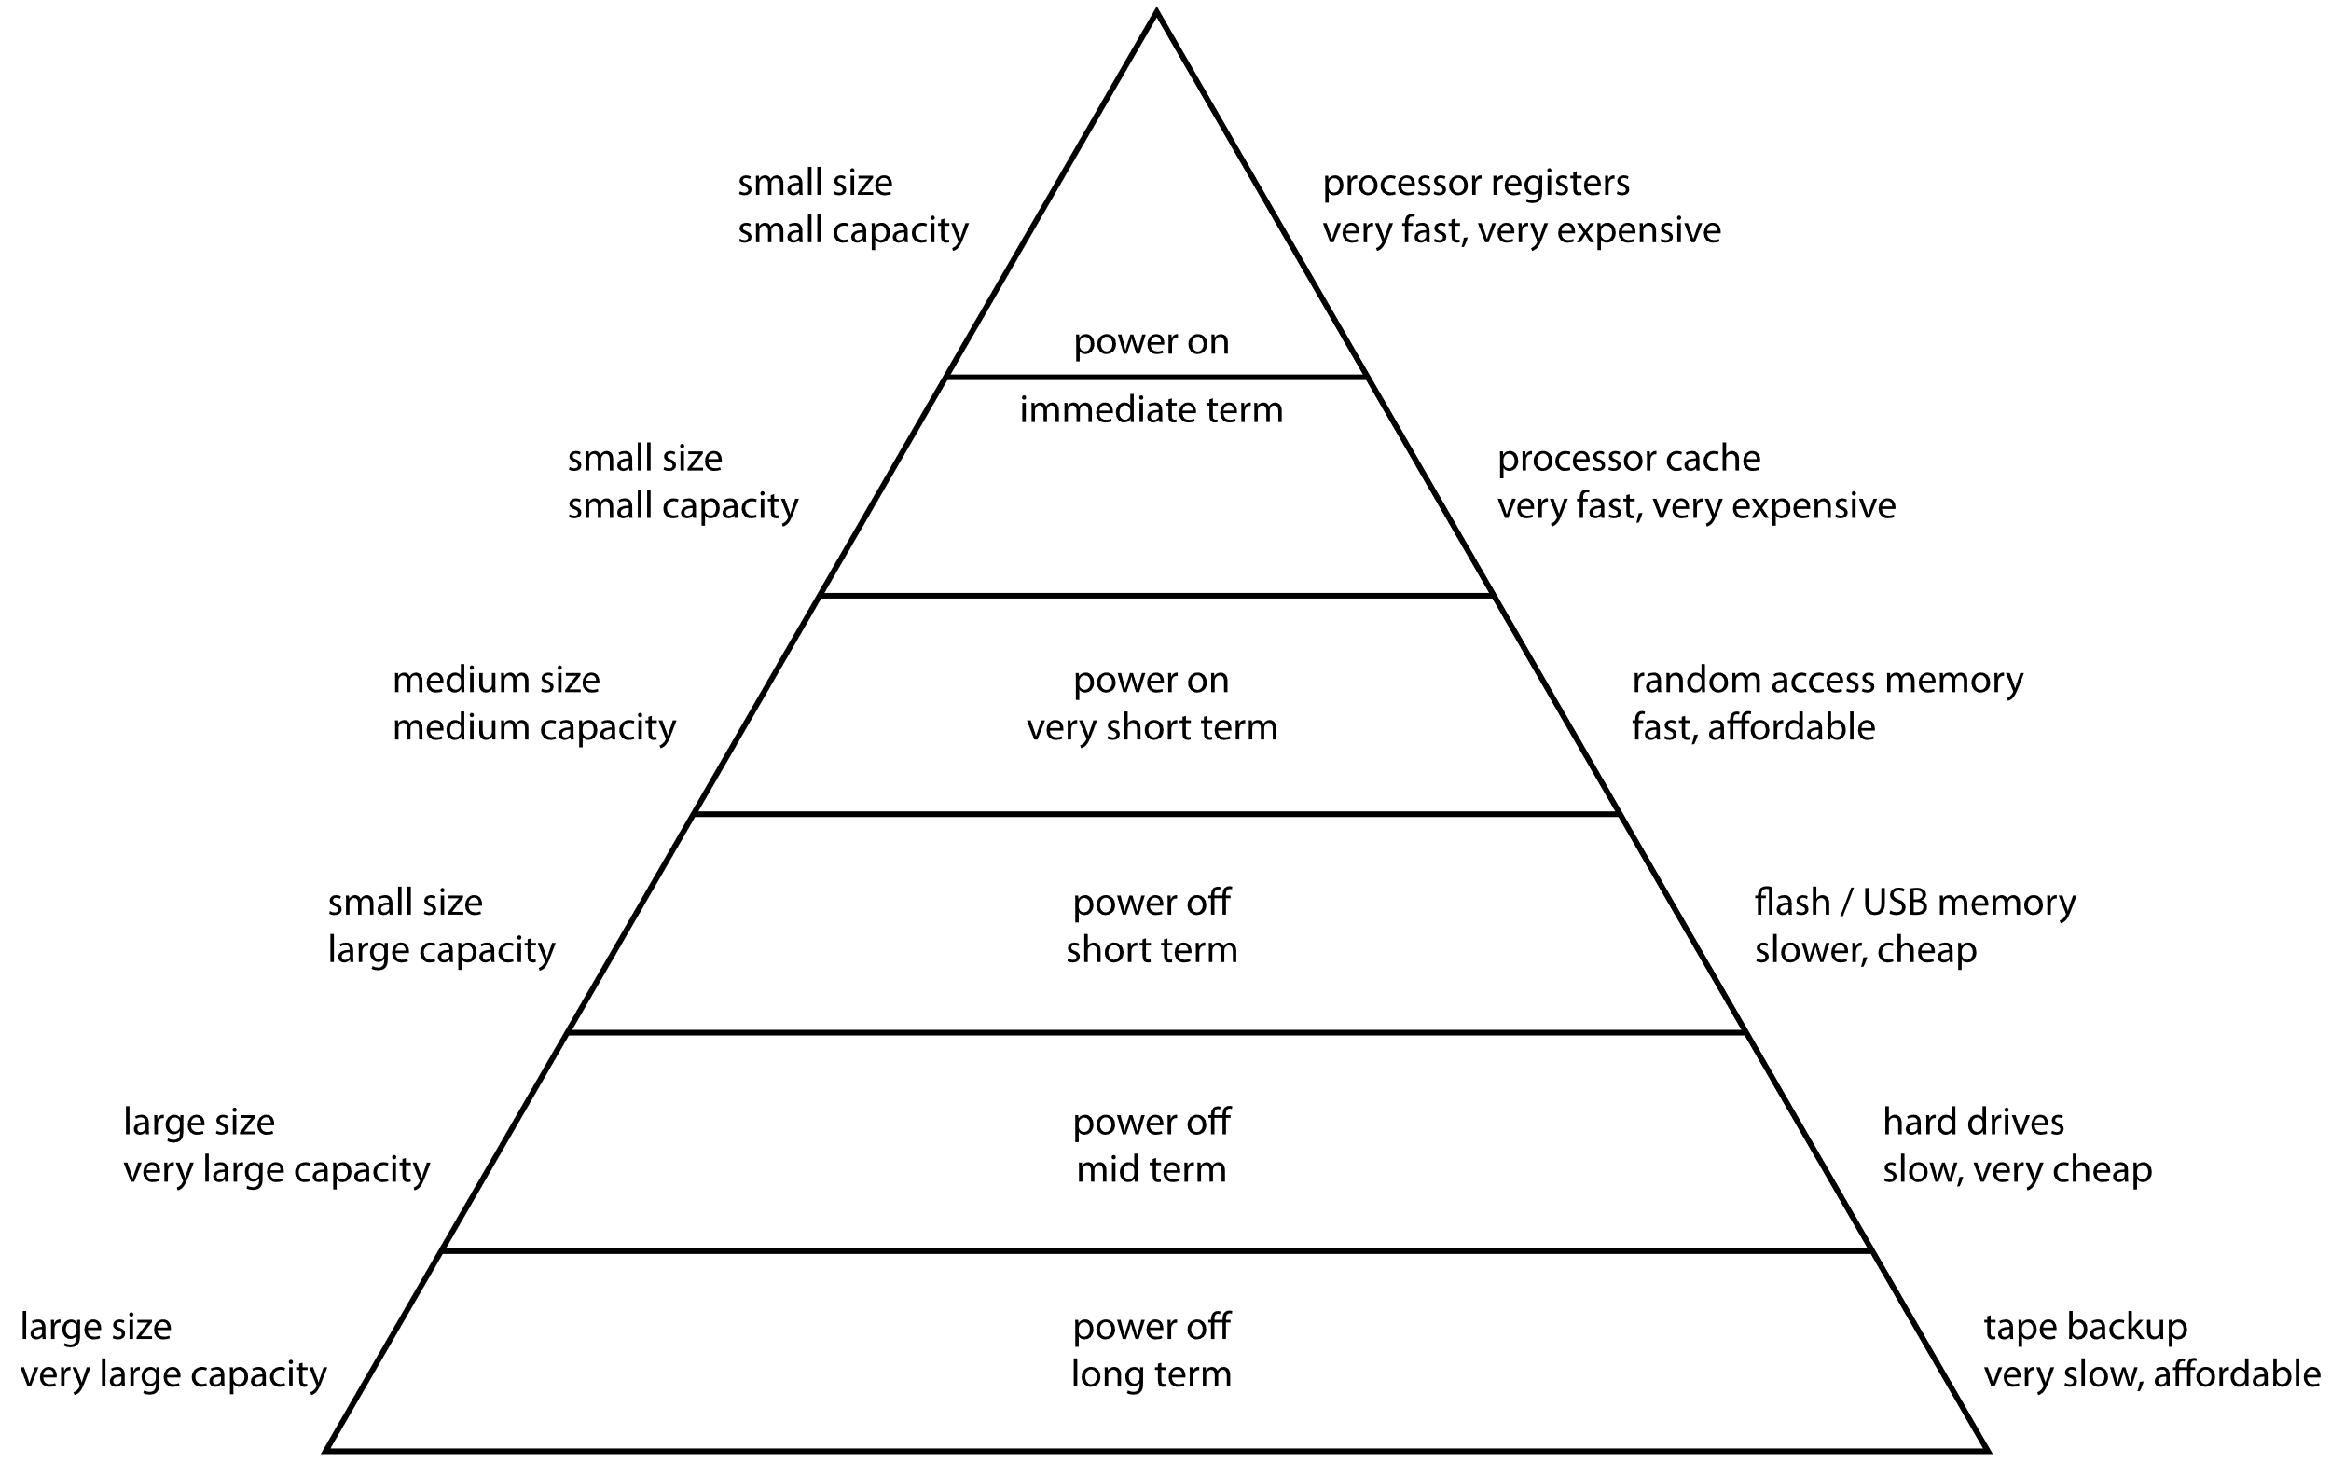
Computer Memory Hierarchy
Source: https://en.wikipedia.org/wiki/Memory_hierarchy

Slide 59
Graphics Processing Unit

Slide 60
Graphics Processing Unit (GPU)
A single-chip processor that is used primarily for 3D applications.
creates lighting effects and transforms objects when a 3D scene is redrawn using mathematically intensive processes.
GPU-accelerated computing is the use of a GPU together with a CPU to accelerate processing such as for scientific, analytical and engineering applications.
GPUs accelerate applications by running the intensive portions of an application and letting the rest run on the CPU.
A CPU consists of a few cores optimised for sequential serial processing while a GPU uses parallel architecture consisting of thousands of smaller more efficient cores designed for handling multiple tasks simultaneously.

Slide 61
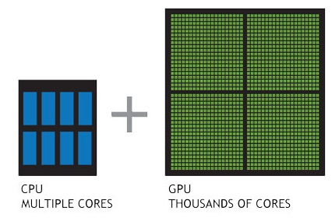
GPU (cont.)

Slide 62
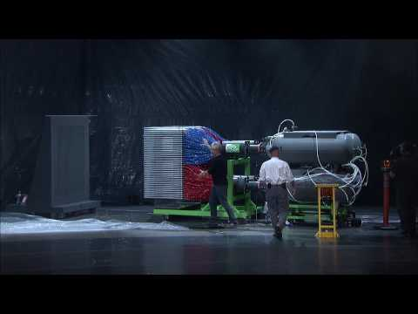
GPU vs CPU
(click to load the video)

Slide 63
Q & A
Notes:
In Slide Show mode, click the arrow to enter the PowerPoint Getting Started Center.

